Slide 1
Python Lists
Collection of elements.
Just like Arrays ~ Dynamic size
Can be Homogeneous (similar datatype elements) or Heterogeneous (different datatype elements)
Lists are Mutable , can be altered after creation.
Allows duplicates.

Slide 2
Creating a List
L = [] //creating a list
print(L)
L = list() //creating a list
Print(L)

Slide 3
Can we have duplicates in a list..?
L= [1,2,3,4,2,2,1,0,-1] //creating a list
print(L)
[1, 2, 3, 4, 2, 2, 1, 0, -1]

Slide 4
Size of a List
L = [] //creating a list
print(len(L))
0
Ls = [1,2,3,4,5,6]
print(len(L))
6

Slide 5
Accessing elements
L = [1,2,3,4] //creating a list
Print(L[0])
1
L = [2, 4.65, ‘a’, “python” ] //creating a list
print(L[0])
print(L[1])
print(L[2])
print(L[3])
print(L[10])
print(L[-1])

Slide 6
Accessing elements
L = [1, [1,2,3] , 3 , [4,3,1] , 5]
print(L[0]) print(L[1][0])
print(L[1]) print(L[1][2])
print(L[2] print(L[1][2])
print(L[3])
1 1
[1,2,3] 2
3 3
[4,3,1]

Slide 7
Accessing elements using loops
L = [1,2,3,4,5]
for i in L:
print(i)
1
2
3
4
5
L = [1,2,3,4,5]
for i in range(len(L)):
print(i, L[i])
0 1
1 2
2 3
3 4
4 5

Slide 8
Accessing elements using negative indexing
List = [1, 2, 'Geeks', 4, 'For', 6, 'Geeks']
print(List[-1]) # print the last element of list
print(List[-3]) # print the third last element of list
Geeks
For

Slide 9
Adding elements in a list
Using append() method
List = [] # Creating a List
print(List)
# Addition of Elements in the List
List.append(1)
List.append(2)
List.append(4)
print(List)
[]
[1, 2, 4]

Slide 10
Adding elements in a list
Using insert() method
List = [1,2,3,4]
print(List)
List.insert(3, 12)
List.insert(0, 'Geeks')
print(List)
[1, 2, 3, 4]
['Geeks', 1, 2, 3, 12, 4]

Slide 11
append() method only works for addition of elements at the end of the List, for addition of element at the desired position, insert() method is used. Unlike append() which takes only one argument, insert() method requires two arguments(position, value).

Slide 12
Adding elements in a list
Using extend() method
extend(), this method is used to add multiple elements at the same time at the end of the list.
List = [1,2,3,4]
print(List)
List.extend([5,6])
print(List)
[1, 2, 3, 4, 5, 6]

Slide 13
Other than append() and insert() methods, there’s one more method for Addition of elements, extend(), this method is used to add multiple elements at the same time at the end of the list.
Note – append() and extend() methods can only add elements at the end.

Slide 14
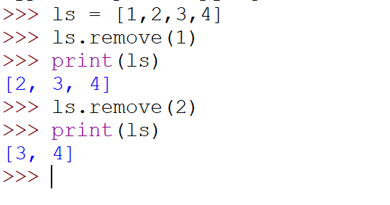
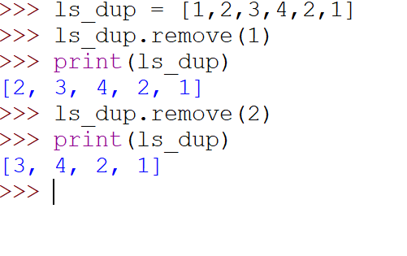
removing elements from the list
Using remove() method
Remove() method only removes one element at a time, to remove out range of elements but an Error arises if element doesn’t exist in the set.

Slide 15
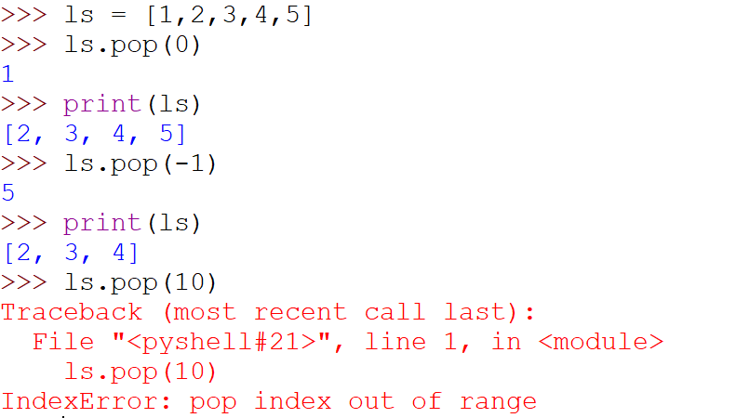
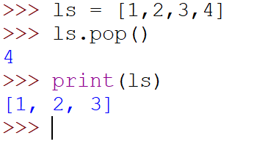
removing elements from the list
Using pop() method
-By default it removes only the last element of the set.
-To remove element from a specific position of the List, index of the element is passed as an argument to the pop() method.

Slide 16
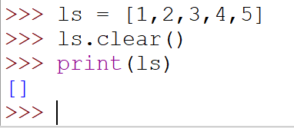
removing elements from the list
Using clear() method
used to erase all the elements of list. After this operation, list becomes empty.

Slide 17
Some more methods
L.count(element) -- Returns the count of number of items passed as an argument
L.index(element) -- Searches for a given element from the start of the list and returns the lowest index where the element appears.
L.sort()
L.sort(reverse=True)
L.reverse()

Slide 18
Some more functions:-
len(L)
sum(L)
max(L)
min(L)

Slide 19
Python Slicing

Slide 20
Slice operation is performed on Lists with the use of a colon(:).
To print elements from beginning to a range use [: Index],
to print elements from end-use [:-Index],
to print elements from specific Index till the end use [Index:],
to print elements within a range, use [Start Index: End Index],
to print the whole List with the use of slicing operation, use [:].
Further, to print the whole List in reverse order, use [::-1].

Slide 21
Some more methods:
min()
max()
len()
sum()
reverse()
in operator
not in operator
+ operator in list → concatenate two lists
* operator in list → multiply the list “n” times and return the single list.
ex: del ls[2 : 5]

Slide 22
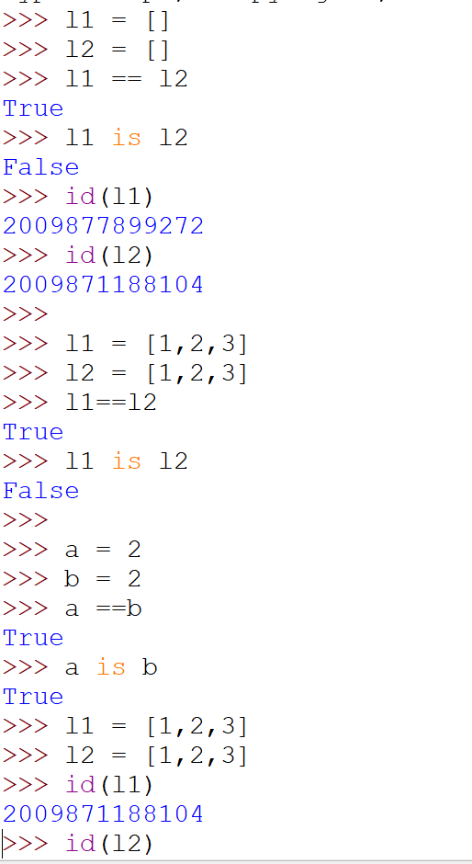



Slide 23
Matrix
L=[[100,200,300], [11,22,33]] Matrix of dimension 2X3
Input Matrix from user
L=[]
rows=int(input(“Enter the number of rows”))
cols=int(input(“Enter the number of columns”))
for i in range(rows):
a=[]
for j in range(cols):
x=int(input())
a.append(x)
L.append(a)
print(L)

